Slide 1

Compare the population of NYC and Toronto

Slide 2
Introduction:
Population plays an essential role in determining a city’s/country’s growth.
For instance:
There are more people to contribute to the govt. tax payment.
The more people earn the stronger GDP becomes.
Employment opportunities
Businesses, exchange of good and services,etc.

Slide 3
Extracting and pre-processing data
Methods used for data extraction
Toronto dataset: data wrangling, Beautiful Soap
New York dataset: extracted from IBM database
Pre-process the data by converting it into data frame.
This was done using Beautiful soap and basic merging and drop operations.
The Toronto dataset was converted by beautiful soap.
New York data was converted by specifying selection parameters.

Slide 4
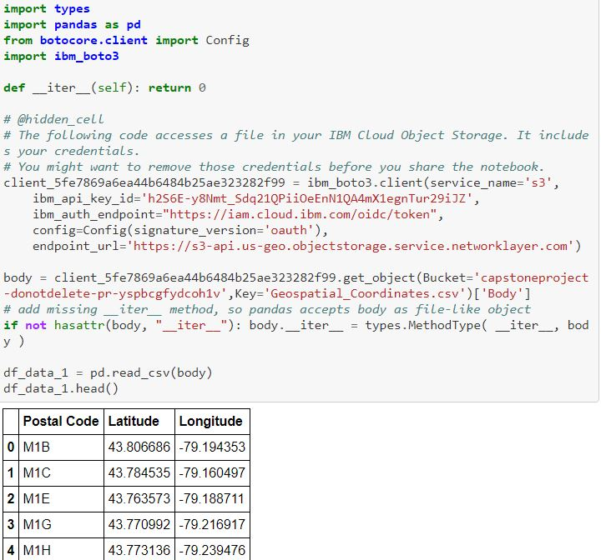
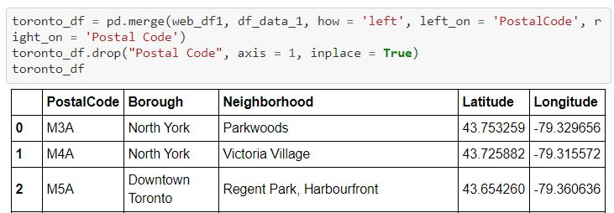
Modifying Data Frame
The data frame for both the data sets was modified, to merge the location attributes.
That is Latitude, Longitude were merged in Toronto dataset using a geographic location .csv file.

Slide 5
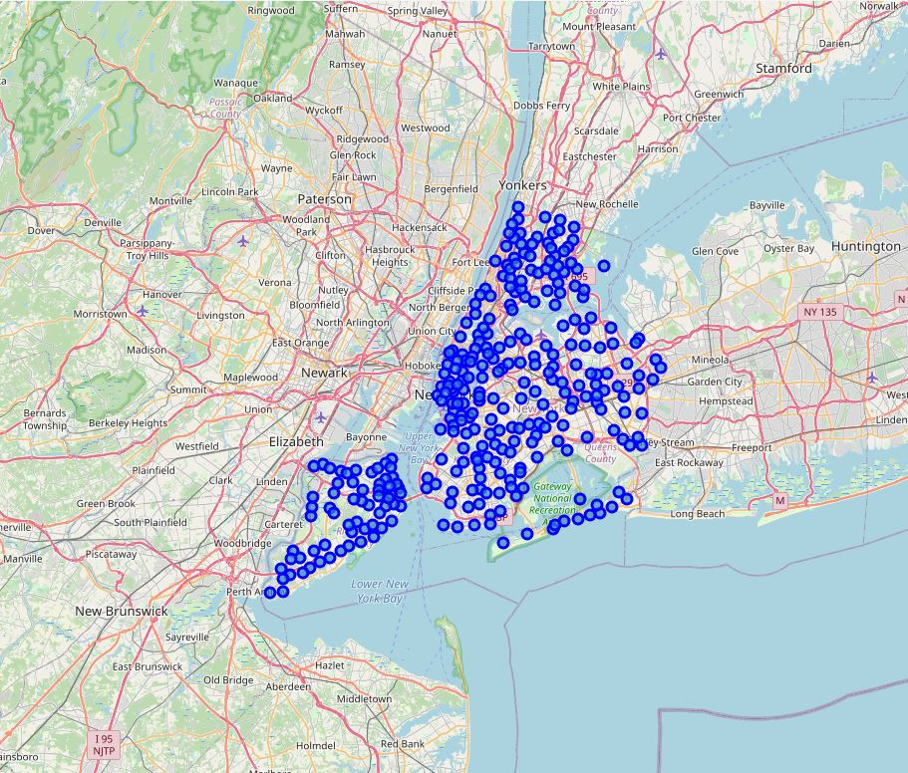
Generating plots using folium and matplotlib
This is the visualization for all the neighborhood in New York city.
Later based on the bar graph, using matplotlib the borough with maximum neighborhood was selected.

Slide 6
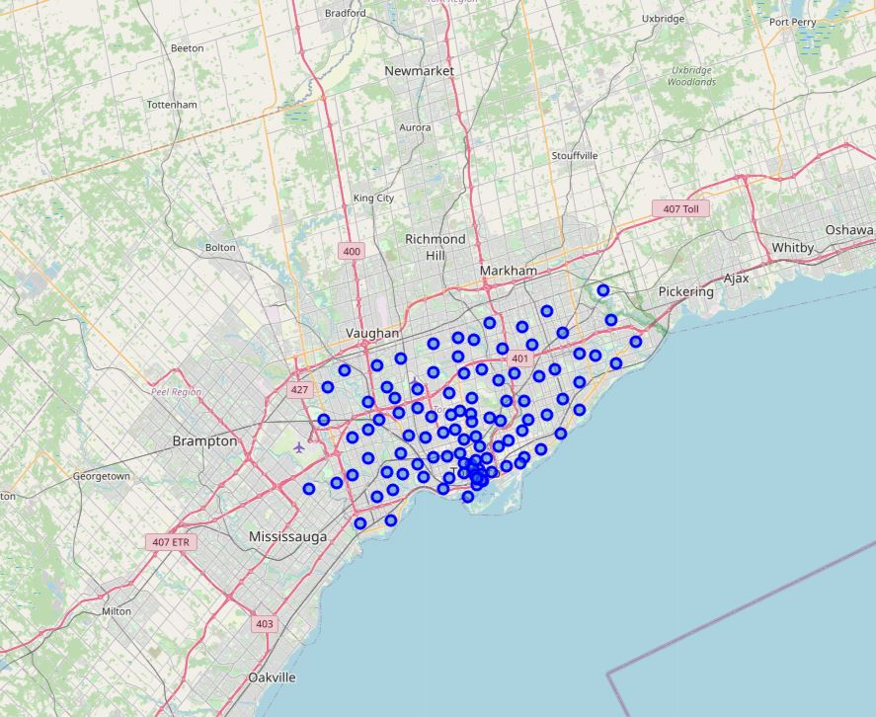
Visualization of Toronto neighborhoods:
A bar chart was generated to identify the maximum number of neighborhoods in the borough.
Based on this result, a folium plot for the Borough containing highest neighborhood was generated.

Slide 7
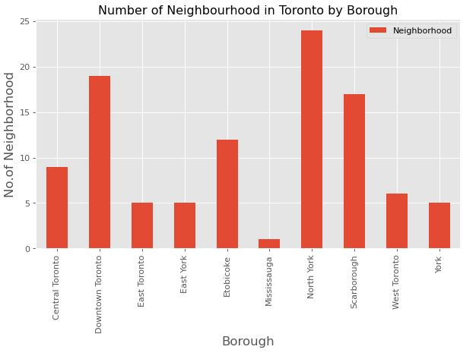
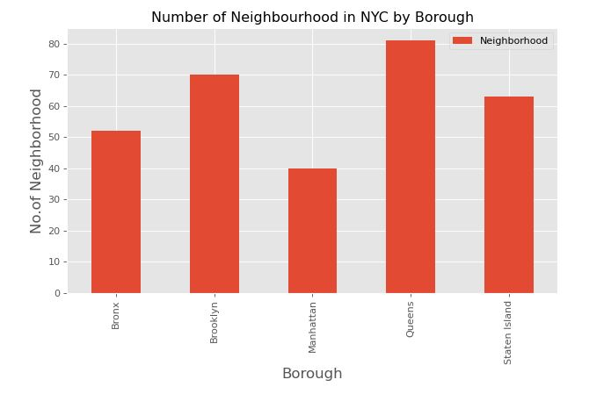
Bar graphs of both the cities:
New York City:
Toronto City:

Slide 8
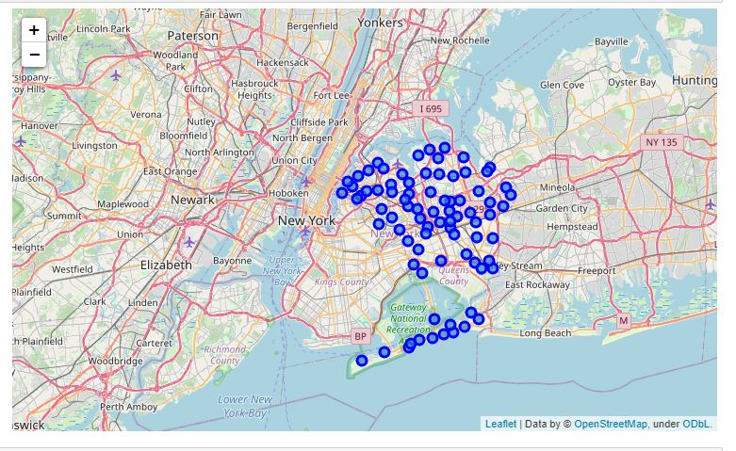
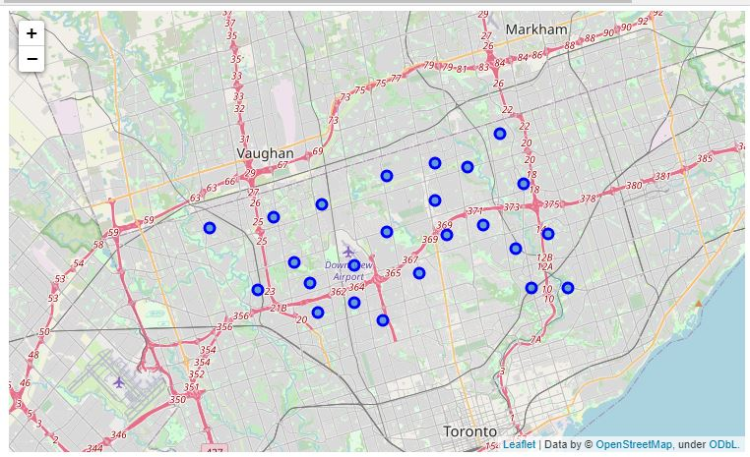
Folium visualizations of Queens and North York, since they are having high neighbors
Queens Figure:
North York Figure:

Slide 9
Results:
After viewing these slides we can get the following instights:
From Queens and North York we will find the total number of venues to understand how populated neighborhoods can help in understanding consumer goods relation ship.

Slide 10
Conclusion and discussion :
The comparision of both the cities can be done more effectively by generating the most trending venues, based on that we can understand the preferences of the people in both the cities.
Unfortunately the "groups" KeyWord always throws error after connecting to Foresquare API while generating venues using latitude and longitude. Despite numerous attempts to restart, stop the kernel or generate a new notebook.
Queens in New york city and North York in toronto city had the highest number of neighborhoods.
Thus, we can say that the Boroughs in NYC are more likely to contribute higher to the city's GDP, Employment, tax, and other factors. On the other hand toronto city boroughs do not have similar impact on the contribution they can have on GDP, Employment, tax etc.
We can clearly see that in the bar graphs since the total number of neighborhoods are less for toronto, than NYC.

